Slide 1
UNIT IV CLOUD MONITORING AND MANAGEMENT
By
M S Rathod,
Lecturer, IT
GP Amravati

Slide 2
Federation of cloud
the practice of interconnecting the cloud computing environments of two or more service providers for the purpose of load balancing of traffic and accommodating spikes in demand.
the deployment and management of several external and internal cloud computing services to match business needs.
Cloud federation requires one provider to wholesale or rent computing resources to another cloud provider.
Those resources become a temporary or permanent extension of the buyer's cloud computing environment, depending on the specific federation agreement between providers.

Slide 3
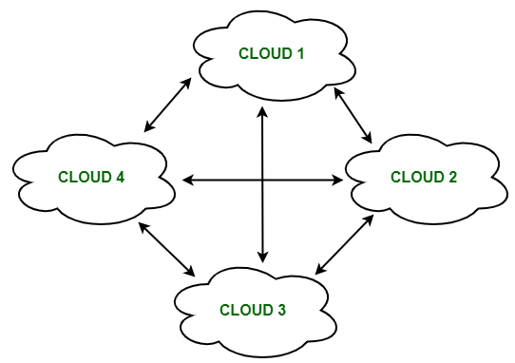
Federation of cloud
It is a multi-national cloud system that integrates private, community, and public clouds into scalable computing platforms.
Federated Cloud

Slide 4
Federation of cloud
Cloud federation offers two substantial benefits to cloud providers.
First, it allows providers to earn revenue from computing resources that would otherwise be idle or underutilized.
Second, cloud federation enables cloud providers to expand their geographic footprints and accommodate sudden spikes in demand without having to build new points-of-presence (POPs).

Slide 5
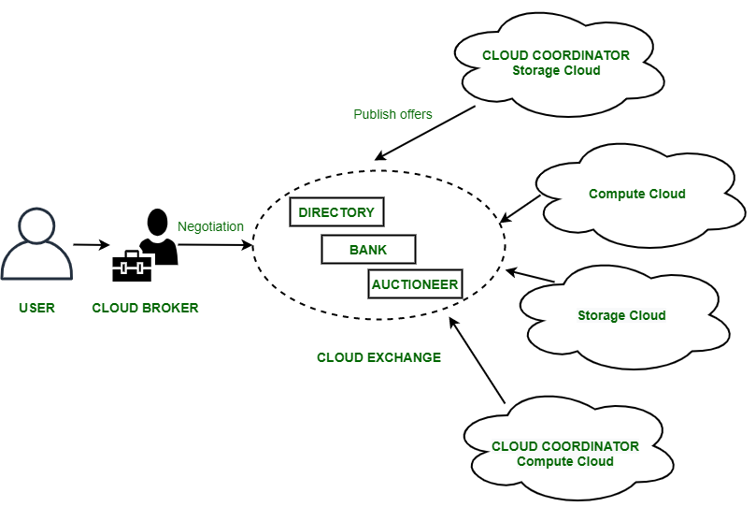
architecture of Federated Cloud

Slide 6
architecture of Federated Cloud
The architecture of Federated Cloud consists of three basic components:
1. Cloud Exchange
The Cloud Exchange acts as a mediator between cloud coordinator and cloud broker.
The demands of the cloud broker are mapped by the cloud exchange to the available services provided by the cloud coordinator.
The cloud exchange has a track record of what is the present cost, demand patterns, and available cloud providers, and this information is periodically reformed by the cloud coordinator.

Slide 7
architecture of Federated Cloud
The architecture of Federated Cloud consists of three basic components:
2. Cloud Coordinator
The cloud coordinator assigns the resources of the cloud to the remote users based on the quality of service they demand and the credits they have in the cloud bank.
3.Cloud Broker
The cloud broker interacts with the cloud coordinator, analyzes the Service-level agreement and the resources offered by several cloud providers in cloud exchange.
Cloud broker finalizes the most suitable deal for their client.

Slide 8
Benefits of Federated Cloud
It minimizes the consumption of energy.
It increases reliability.
It minimizes the time and cost of providers due to dynamic scalability.
It connects various cloud service providers globally. The providers may buy and sell services on demand.
It provides easy scaling up of resources.

Slide 9
SERVICE LEVEL AGREEMENT
A service-level agreement (SLA) is a contract between a service provider and its customers that documents what services the provider will furnish and defines the service standards the provider is obligated to meet.
Service providers need SLAs to help them manage customer expectations and define the severity levels and circumstances under which they are not liable for outages or performance issues.
Customers can also benefit from SLAs because the contract describes the performance characteristics of the service -- which can be compared with other vendors' SLAs -- and sets forth the means for redressing service issues.

Slide 10
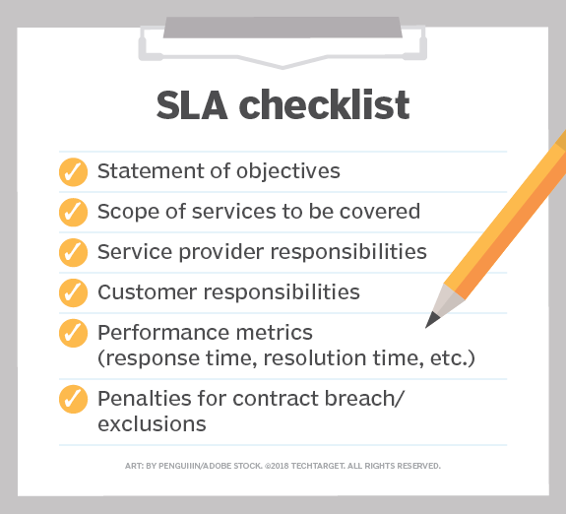
SERVICE LEVEL AGREEMENT

Slide 11
TYPES OF SLAs
There are three basic types of SLAs: customer, internal and multilevel service-level agreements.
A customer service-level agreement
It is between a service provider and its external customers. It is sometimes called an external service agreement.
In a customer-based SLA, the customer and service provider come to a negotiated agreement on the services that will be provided.

Slide 12
Customer sla
A customer service-level agreement includes:
exact details of the service expected by the customer;
provisions of the service availability;
standards for each level of service;
each party's responsibilities;
escalation procedures; and
terms for cancellation.

Slide 13
INTERNAL SLA
An internal SLA is between an organization and its internal customer -- this could be another organization, department or site.
That means that although a company could have an SLA open with each of its customers, it might also have a separate SLA between its marketing and sales departments.
For instance, a company's sales department has nearly $10,000 worth of sales every month, with each sale worth $500. If the sales team's average closing rate is 20%, then sales knows that marketing must deliver at least 100 qualified leads every month.

Slide 14
MULTILEVEL SLA
A multilevel SLA will divide the agreement into various levels that are specific to a series of customers using the service.
For example, a software as a service (SaaS) provider might offer basic services and support to all customers using a product, but they could also offer different price ranges when buying the product that dictates different service levels.
These different levels of service will be layered into the multilevel SLA.

Slide 15
Life cycle of sla
Each SLA goes through a sequence of steps starting from
identification of terms and conditions,
activation and monitoring of the stated terms and conditions and
eventual termination of contract once the host relationship ceases to exist.
Such a sequence is called as life cycle of SLA
It consists of five phases.

Slide 16
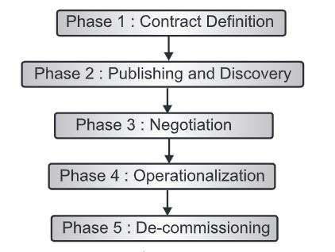
Life cycle of sla

Slide 17
Life cycle of sla
1. Contract Definition:
Generally, service providers define a set of service offerings and corresponding SLAs using standard templates.
2. Publication and discovery:
Service providers advertises these base service offerings standard publication media, and the customers should be able to locate be able to the service provider by searching the catalog.
The customer can search different competitive offerings and shortlist a few that fulfill their requirements for further negotiation.

Slide 18
Life cycle of sla
3. Negotiation:
Once the customer has discovered a service provider who can meet their application hosting need, the SLA terms and conditions needs to be mutually agreed upon before signing the agreement.
4.Operationalization:
SLA operation consists of SLA monitoring , SLA accounting and SLA enforcement.
SLA monitoring : measuring parameters and calculating matrix defined as a part of SLA and determining the deviations.

Slide 19
Life cycle of sla
SLA accounting : capturing and archiving the SLA adherence for compliance.
SLA enforcement : taking appropriate action when the runtime monitoring detects a SLA violation.
5. De-commissioning:
Termination of all the activities performed under a particular SLA when the hosting relationship between the service provider and the customer has ended.
SLA specifies terms and conditions of contract termination and specifies the situations under which this SLA has legally ended.

Slide 20
Service CATALOG
It is a single source of accurate information on all cloud services offered by CSP.
Service Catalog allows organizations to create and manage catalogs of IT services that are approved for use on cloud.
These IT services can include everything from virtual machine images, servers, software, and databases to complete multi-tier application architectures.

Slide 21
Service CATALOG
Service Catalog allows you to centrally manage deployed IT services and your applications, resources, and metadata.
This helps customer achieve consistent governance and meet your compliance requirements, while enabling them to quickly deploy only the approved IT services they need.
Customer can define and manage applications and their metadata, to keep track of cost, performance, security, compliance and operational status at the application level.

Slide 22
COMPOSITION OF SERVICE CATALOG
1. An identification label for the service
2. Description of service.
3. related service request types.
4. Any supporting or underpinning services.
5. Service categorization.
6. Interface and dependencies between all services.
7. clear ownership and accountability of the service.
8. Associated costs.
9. Escalation points and key contracts
10. Service level agreement data.

Slide 23
Service CATALOG MANAGEMENT
Objective of service catalog management is:
Manage the information contained in the service catalog.
Ensure that the service catalog is accurate and reflects the current details , status, interfaces and dependencies of all services that are being run or being prepared to run.
Ensure that the service catalog is made available to those approved to access it in a manner that supports their effective and efficient use of service catalog information.

Slide 24
CLOUD PORTAL and its functions
a cloud portal is a point of access for the cloud platform.
Cloud portals are run using software that gives end users access to the virtual environment of the cloud platform.
They can be used to access applications developed on cloud based platform.
https://aws.amazon.com/
https://cloud.google.com/

Slide 25
Functions of CLOUD PORTAL
The Cloud Portal provides information about the service for which the user has an active subscription.
Self-service on-demand capabilities
Single pane of glass for a consolidated view of cloud services.
Consolidation of account management

Slide 26
CLOUD SERVICE LIFE CYCLE
Service planning
service creation
service operation
service termination

Slide 27
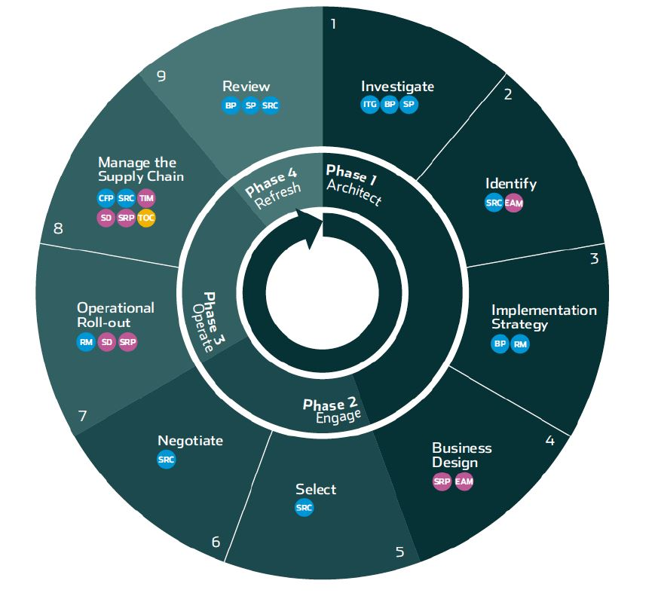
CLOUD SERVICE LIFE CYCLE
Service Termination
Service Planning
.
Service Operation
Service Creation

Slide 28
CLOUD SERVICE LIFE CYCLE
Phase 1 : Architect : The first phase starts with the investigation and planning of the cloud project.
Step 1:
This step provides an insight into and an understanding of what an organization wants to achieve by moving to the cloud, and what goals and expectations are to be met.
Step 2:
Objectively assess what areas of the business are appropriate to outsource to the cloud and what impact this will have on the current delivery model. This will require an understanding of the current state, so that it can be compared to the desired future state.
At a minimum, the impact on the service, people, cost, infrastructure, stakeholders and how the impact will be managed should be considered.

Slide 29
CLOUD SERVICE LIFE CYCLE
Phase 1 : Architect : The first phase starts with the investigation and planning of the cloud project.
Step 3: Implementation Strategy
Define at a strategic level how the cloud services that are to be outsourced will be rolled out(launched or introduced).
This will document how key decisions will be made later on, by defining strategies on: staffing, communication, program roll-out, organizational rules, and risk assessment.

Slide 30
CLOUD SERVICE LIFE CYCLE
Step 4: Business Design
Design what is to be outsourced to the cloud and what the future state will look like.
This will detail the new service, how it will be managed, how it interfaces to the existing / remaining systems, and how it will be monitored and reported.

Slide 31
CLOUD SERVICE LIFE CYCLE
Phase 2: Engage:
The second phase selects a service provider that can deliver the required cloud service.
Step 5: Select
Based on the requirements and the other criteria defined by the Architect phase this step will select the best supplier based on value, sustainability, and quality.
Step 6: Negotiate
This step is to complete the final negotiation, pick the preferred supplier, get internal approval and sign the contract(s) (SLAs).

Slide 32
CLOUD SERVICE LIFE CYCLE
Phase 3 Operate: The third phase is the implementation and the day-to-day management of the cloud service.
Step 7: Operational Roll-out
To put together a project team that will manage the transition of the agreed services to the new cloud service.
This will require the transition of the service itself, the management of staff impacted, communication to all stakeholders, knowledge retention / transition, and acceptance sign-off (Signature of all stakeholders).

Slide 33
CLOUD SERVICE LIFE CYCLE
Step 8: Manage the Supply Chain
It is important to manage the new cloud service as efficiently and effectively as possible.
The organization will need to adapt to the new setup, particularly at IT management level – because rather than directly managing internal resources, the requirement will be to manage the cloud supplier and in particular the supplier relationship.
This will require effective monitoring and control so that issue, variations and disputes can be resolved to the satisfaction of both parties.

Slide 34
CLOUD SERVICE LIFE CYCLE
Phase 4 Refresh: The fourth phase is the ongoing review of cloud services.
Step 9: Review
To review the cloud service requirements based on: the cloud service itself, other changes within the business, changes within the supplier organization, or the need to change the supplier.

Slide 35
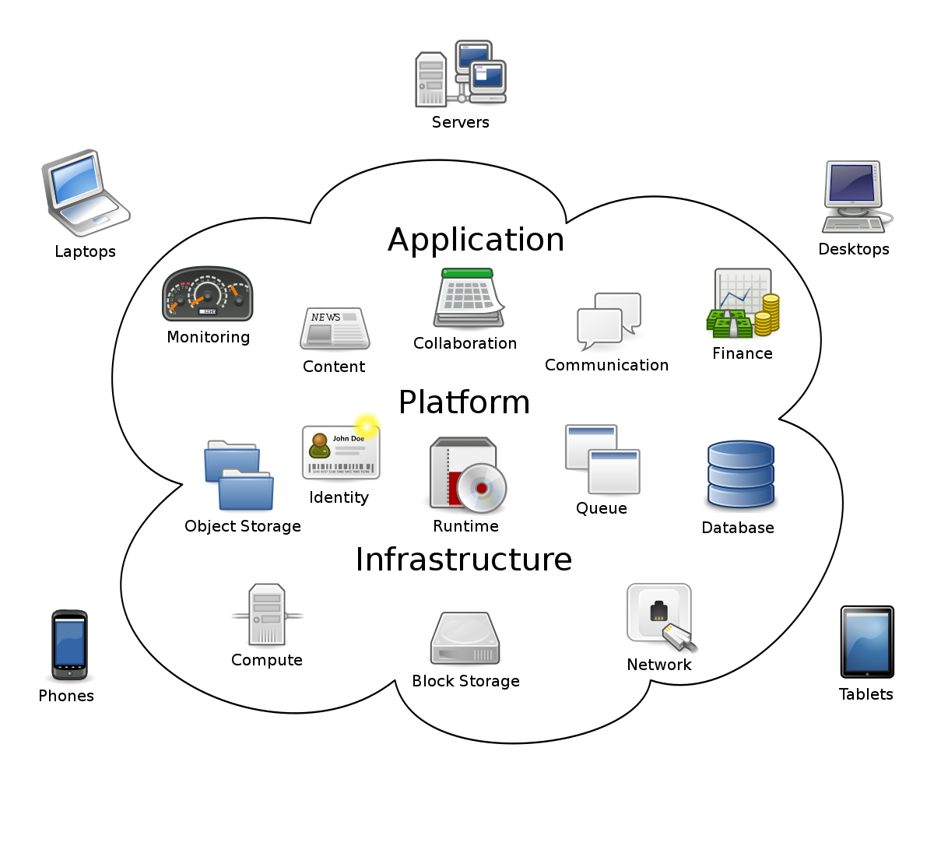
CLOUD Resource MANAGEMENT
.

Slide 36
CLOUD Resource MANAGEMENT
.
Resource Management is process which effectively and efficiently manages resources as well as providing QoS guarantees to cloud consumers.

Slide 37
Classification of CLOUD resources
Faster Computation: Processor, Memory, Algorithm, OS,APIs
Storage: Hard Drive, flash drive, HDFC,GFS, Database servers.
Communication/Network: Physical- Intermediate Devices, hosts/workstation, sensors, Communication links
Logical- Bandwidth, delay,protocol
Power: Cooling devices, UPS
Security: Trust, Authentication, Integrity, Privacy, Availability.

Slide 38
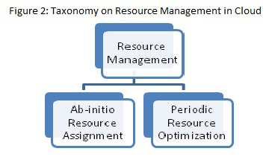
TAXONOMY ON CLOUD RESOURCE MANAGEMENT
The goal of resource management in cloud computing is
to provide high availability of resources, sharing of resources, fulfilling time variant service model, providing efficiency and reliability on resource usage

Slide 39
AB-INITIO Resource assignment
It is initial resource assignment, in a manner that resources are requested by application (on behalf of cloud consumers) first time.
Figure 3 shows several sequential steps which needs to be followed for completion of this phase.

Slide 40
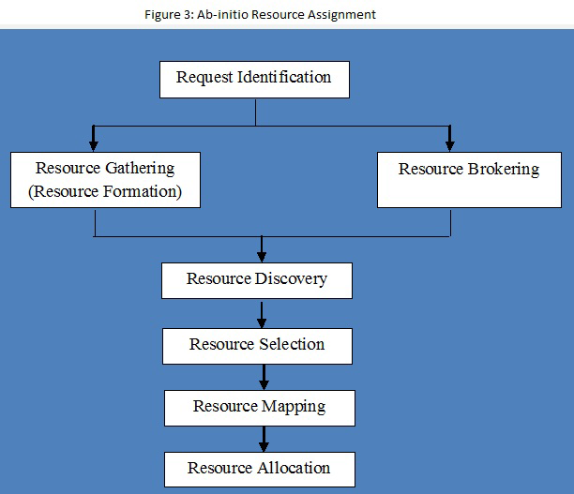
AB-INITIO Resource assignment
It is initial resource assignment, in a manner that resources are requested by application (on behalf of cloud consumers) first time.
Figure 3 shows several sequential steps which needs to be followed for completion of this phase.

Slide 41
AB-INITIO Resource assignment
Request Identification:
This is the first and foremost step in Ab-initio Resource Assignment.
In this step, various resources will be identied by cloud providers.
Resource Gathering / Resource Formation: After identification of resources in step 1, gathering or formation of resources will take place.
This step will identify available resources.

Slide 42
AB-INITIO Resource assignment
Resource Brokering:
This step is negotiation of resources with cloud
consumers to make sure that they are available
as per requirement.
Resource Discovery:
This step will logically group various resources as
per the requirements of cloud consumers.
Resource Selection:
This step is to choose best resources among
available resources for requirements provided by
cloud consumers.

Slide 43
AB-INITIO Resource assignment
Resource Mapping:
This step will map virtual resources with physical
resources (like node, link etc) provided by cloud
providers.
Resource Allocation:
This step will allocate / distribute resources to the cloud consumers.
It's main goal is to satisfy cloud consumers' need and revenue generation for cloud providers.

Slide 44
Periodic resource optimization
As name suggest this is a phase where resource management is done at regular intervals once phase 1 is completed.
Here periodic resource optimization is presented as a process for two different categories of resources which are non-virtualized resources and virtualized resources
The non-virtualized resources are also called as physical resources.
For both categories of resources, periodic resource optimization contains similar steps.
The only difference is that virtualized resources can be assembled together as per the resource requirement and can be disassembled also.

Slide 45
Periodic resource optimization
So periodic resource optimization for virtualized resources contains two steps more compared to non-virtualized resources which are Resource Bundling and Resource Fragmentation.

Slide 46
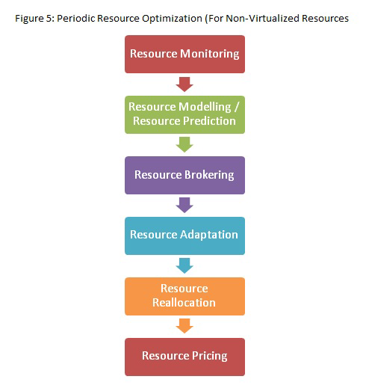
Periodic resource optimization

Slide 47
Periodic resource optimization
1. Resource Monitoring: the first and crucial step in Periodic Resource Optimization.
Various non-virtualized cloud resources are monitored to analyze utilization of resources.
This step will also monitor availability of free resources for future purpose.
2. Resource Modeling / Resource Prediction:
This step will predict the various non-virtualized resources required by cloud consumers applications.
This is one of the complex step as cloud resources are not uniform in nature.
Due to this non uniformity, it is very difficult to predict resource requirement for peak periods and as well as for non-peak periods.

Slide 48
Periodic resource optimization
3. Resource Brokering:
This step is negotiation of non-virtualized resources with cloud consumers to make sure that they are available as per requirement.
4. Resource Adaptation:
As per the requirements of cloud consumers, non-virtualized cloud resources can be scaled up or scaled down.
This step may increase cost from cloud providers perspective.

Slide 49
Periodic resource optimization
5. Resource Reallocation:
This step will reallocate / redistribute resources to the cloud consumers.
It's main goal is to satisfy cloud consumers' need and revenue generation for cloud providers.
6. Resource Pricing:
It is one of the most important step from cloud providers and cloud consumers perspective. Based on cloud resource usage pricing will be done.

Slide 50
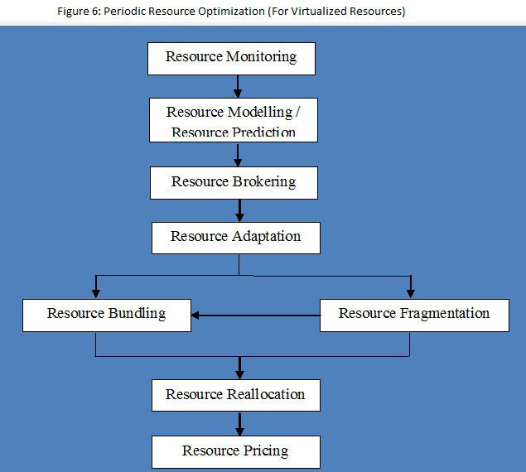
Periodic resource optimization (for virtualized resources)

Slide 51
Periodic resource optimization (for virtualized resources)
Resource Bundling: As per the requirement various non-virtualized resources can be bundled into virtualized resources.
Resource Fragmentation: Various virtualized resources needs to be fragmented to make non virtualized resources free.
After this step various non-virtualized resources can be bundled in to virtualized resources as a part of resource bundling.

